Slide 2
ddto start with –Quick recapD

Slide 3
ddWhat is a Wheelbarrow, again?d
It is an empty powerless vessel, that is filled by something or someone else and pushed by something and someone else.

Slide 4
ddEpigenetic Refresherd
Remember your DNA doesn’t change, but many factors influence the way the genetic information plays out.
Even ‘encode’ over time. It can be slow and subtle, but that’s how much influence all the RECIPE factors can have on outcomes – we have some influence over changing them.

Slide 5
DDDDAll Young Cannabis Users face psychosis RiskD
“This finding means that all young cannabis users face psychosis risk, not just those with a family history of schizophrenia or a biological factor that increases their susceptibility to the effects of cannabis – The whole population is prone to have this risk..
Patricia J. Conrod, PhD, professor of psychiatry, University of Montreal, Canada, https://www.dalgarnoinstitute.org.au/images/resources/pdf/cannabis-conundrum/All_Young_Cannabis_Users_Face_Psychosis_RiskMedscape2018.pdf

Slide 6
DDDDCannabis Exposure During Critical Windows ofD DDDDDevelopment: Epigenetic and Molecular PathwaysD DDDDImplicated in Neuropsychiatric DiseaseD
Developmental cannabis exposure alters epigenetic processes with functional gene consequences. These include potentially heritable alterations in genes and molecular pathways critical for brain development and associated with
autism spectrum disorder (ASD),
attention deficit hyperactivity disorder (ADHD),
schizophrenia,
addiction,
and other psychiatric diseases.
Springer Academic https://link.springer.com/content/pdf/10.1007/s40572-020-00275-4.pdf

Slide 7
However, that debate has been done and dusted. It is a remarkable combination of both. One of the better ways to look at how we are developed is by using the idea of a R.E.C.I.P.E. (We use the following acrostic)
Relationships
Environment
Conduct (how you behave and why)
Information
Paradigm and Practice (your worldview and how you live it out)
Epigenetics

Slide 8
“It is now clear that experience, be it
environmental toxins,
maternal behavior,
psychological or physical stress,
learning,
drug exposure, or
psycho-trauma,
leads to active regulation of the chemical and three-dimensional structure of DNA in the nervous system…These epigenomic changes lead to alterations in gene readout (and who knows what else?) in cells in the nervous system that trigger lasting, and in some cases perpetual, changes in neural function.”
(The Emerging Field of Neuroepigenetics J. David Sweatt, Department of Neurobiology and Evelyn F. McKnight Brain Institute, University of Alabama at Birmingham, Birmingham, AL 35294, USA http://dx.doi.org/10.1016/j.neuron.2013.10.023

Slide 9
In this session we are going to start you looking at the other 5 ‘ingredients’ in the R.E.C.I.P.E. that is YOU!
Relationships
Environment
Conduct (how you behave and why)
Information
Paradigm and Practice (your worldview and how you live it out)

Slide 10
There are many learning and socializing models, but our journey we are going to start you investigating the following model:
Affective Learning
Operant Learning
Observational Learning
Cognitive Learning
Cultural Learning

Slide 11
In the early stages of this socialisation/learning process, how the infant feels has profound consequences. (These also matter later stages of life too)
Safety – Security – Tenderness – Care – Affection

Slide 12
In the early stages of this socialisation/learning process, the child is ‘trying things out’ – What the care giver does in this early stage will determine was behaviours/activities are extinct or developed. This is done by what is allowed or not allowed by the care giver. Boundary Setting, structure and discipline is vital at early stage and continues through later developmental stages too
Attempting – Inquisitive – Trial & Error – Boundaries

Slide 13
In the early stages of this socialisation/learning process, the child is watching and listening to not only the care giver, but also the environment they are in. – the actions, behaviours, words, tone, and the activities in the environment make a strong impression on the infant (and in future stages of development too) More is ‘caught than taught’ in this space
Modelling – Demonstration – Mimicking – Correction

Slide 14
In the early stages of this socialisation/learning process, the child is developing their own interpretations of their environment and beginning to investigate, question and evaluate, separately, but not independent of the relational care giver environment. Learning how to think critically, logically rationally is geared not only to information, but also values and belief systems. Also that this process oversees feelings, is not driven by them Wisdom – Logic – Evaluation – Analysis – Values – World View

Slide 15
This socialisation/learning stage really begins once the child commences relationship with peers, but more so in the non-supervised independent peer interaction environment. The influence – positive or negative – of the ‘cultural/peer’ environment is impacted by teens priorities, sense of self, strength of values and family environment and how secure that makes them feel. If you, as a teen, have no filters, no resiliency, then the likelihood that ‘whatever my peers do is okay by me’, will be the narrative. What is needed
Clear Vision/Direction – Values – Security – Trusted Wiser Mentors

Slide 16
Understanding a little more about how we learn and grow in our understanding of the world, what specific learning process did you feel helped you make smarter and healthier decisions and why was that?
And what process was unhelpful and why?
Discuss

Slide 17
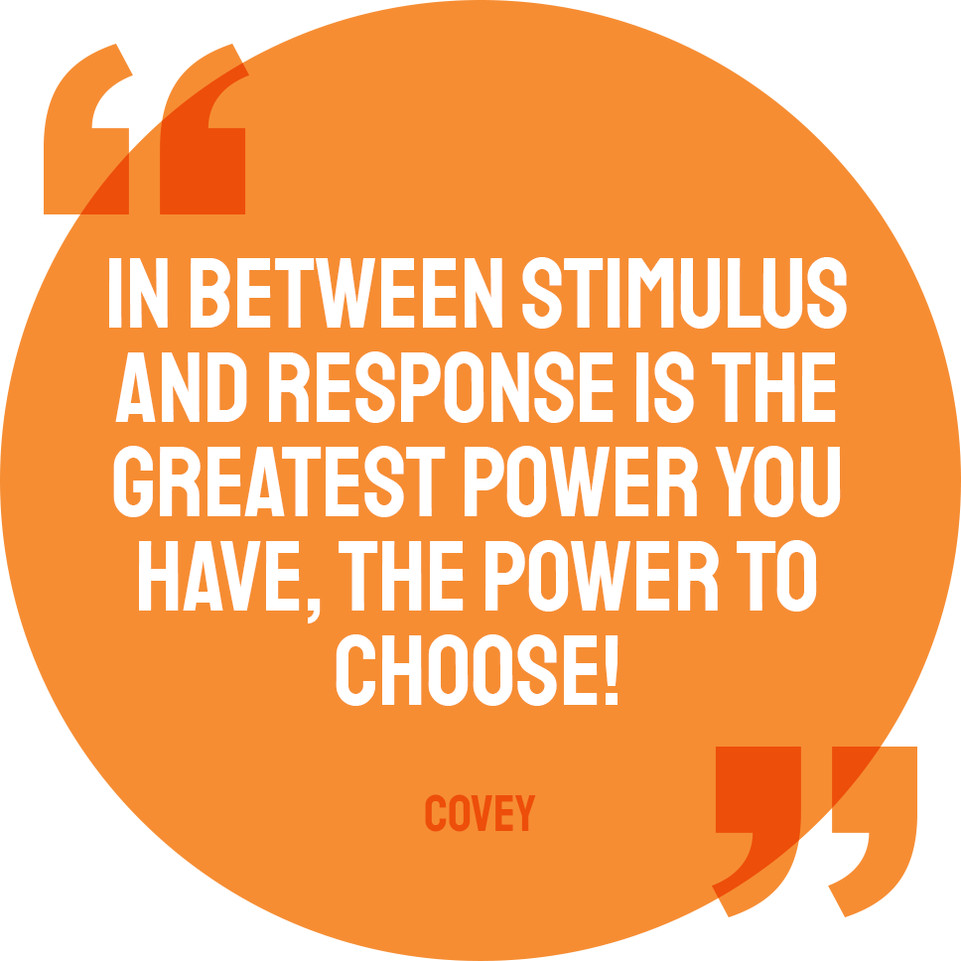

Slide 18
Strengthening my BUNGEE Rope, by adding to Scripting Tool-kit
Evidence now proves, all young cannabis users face psychosis risk.
Who and How we are is made up of a lot of factors, including our environments, decisions, values and behaviours.
Drug use messes with your genes. Your choices really matter, particularly around substance use as it will not only impact brain development but can also influence genetic expression for the worse.
Environments matter – Not just where, but who with and the activities and practices you’re part of. (some you have no control over, but others you do) – Exercise your power to choose well!

Slide 20
Strengthening my BUNGEE Rope – Filling Your Wheelbarrow with good stuff!
Click on links below
Pathways from epigenomics
Drug Policy Building or demolishing community resiliency
Social Determineants & Substance Use
Cannabis Conundrum Information Sheet
Vaping crisis Information Sheet
MORE RESOURCES FOR BUILDING RESILIENCY WITHOUT DRUG USE
www.dalgarnoinstitute.org.au

