Slide 2
ddSome Basic Learning & Teaching Principlesd ddto start with – kick off with scienced

Slide 3
ddWhat is a Wheelbarrow?d
It is an empty powerless vessel, that is filled by something or someone else and pushed by something and someone else.
So, it is really important to know who and what is ‘filling you’, right?

Slide 4
Human beings are designed like no other creature.
Most animals have a super amount of automated processes built in, but very small capacity to add in and grow beyond a predetermined set of biological factors.
With Humans it’s pretty much all about learning and learning and more learning!
What you learn! Why you learn! How you learn!

Slide 5
Are we the result of Nature?
Us human beings are not just a ‘blue-print’ – a set of predetermined plans that build us.
Are we the result of Nurture?
Nor are we solely a ‘lump of clay’ that is completely molded by our environments.
This was a pretty consistent debate about how people develop until about 10 - 15 years ago.

Slide 6
However, that debate has been done and dusted. It is a remarkable combination of both. One of the better ways to look at how we are developed is by using the idea of a R.E.C.I.P.E. (We use the following acrostic)
Relationships
Environment
Conduct (how you behave and why)
Information
Paradigm and Practice (your worldview and how you live it out)
Epigenetics

Slide 7
Like all recipes, we humans have all pretty much exactly the same core ingredients that define us as the human mammal. When some, let’s say core ‘ingredients’ are missing or added into the DNA, you can see the difference quite clearly either through appearance or function or that person.
However, that’s not the case for the overwhelming majority of us. We do have all the core genetic ingredients for our ‘wheelbarrow-cake’, if you like, but like all recipes, it is also about the following factors…
Timing of additions
Mix of ingredients
Tainted ingredients getting in
Length of resting
About little unhelpful ‘spice ups’
Time in the oven and so on!

Slide 8
Our focus in this session is:
ddEpigeneticsE
So in simplest terms:
Epi (on top of) genetics, is best defined as the study of changes in organisms brought about by modification of gene expression, rather than by alteration of the genetic code in the form of DNA.

Slide 9
Our focus in this session is:
ddEpigeneticsE
The epigenome consists of nuclear information, heritable during cell division, that controls development, tissue differentiation, and cellular responsiveness.
Epigenetic information is controlled by genome sequence, environmental exposure, and stochasticity…
As such, epigenetics stands at the interface of the genome, development, and environmental exposure.

Slide 10
Our focus in this session is:
ddEpigeneticsE
All cells of the body have essentially the same DNA, yet different organs and tissues serve vastly different functions and also retain their identity as their cells divide.
This cellular identity is epigenetic information, or information that is ‘ontop’ the genes themselves…

Slide 11
Our focus in this session is:
ddEpigeneticsE
Remember your DNA doesn’t change, but many factors influence the way the genetic information plays out.
Even ‘encode’ over time. It can be slow and subtle, but that’s how much influence all the RECIPE factors can have on outcomes – we have some influence over changing them.

Slide 12
Our focus in this session is:
ddEpigeneticsE
For instance…Exposure to nicotine and other toxins causes substantial epigenetic changes in smokers, as well as in the cord blood and placenta of fetuses exposed prenatally, affecting genes involved in normal pulmonary (lung) function and cancer…

Slide 13
Our focus in this session is:
ddEpigeneticsE
Also…Exercise has mechanistically important effects on the skeletal-muscle epigenome, as may trauma in early life. Recently, post-traumatic stress disorder has been linked to epigenetic changes prospectively.
The Key Role of Epigenetics in Human Disease Prevention and Mitigation Andrew P. Feinberg, M.D., M.P.H. New England Journal of Medicine 378; 14 nejm.org April 5, 2018

Slide 14
Our focus in this session is:
ddEpigeneticsE
Understand all the other components of the RECIPE, relationship, environment, conduct, information and practice can all also influence the epigenome and how it can shape you.
So, when we stop being wheelbarrows and start choosing best-practice for best health and well-being outcomes, we can be more self-determining.

Slide 15
Our focus in this session is:
ddEpigeneticsE
However, if we choose to stay in bad relationships, poor environments and listen to the wrong information and act out poorly, then we reinforce, mess.
I’ve never met anyone yet who in principal doesn’t want to be a badly manipulated wheelbarrow, but the choices they continue to make often keep them there.

Slide 16
Our focus in this session is:
ddEpigeneticsE
However, one thing that will more quickly mess up, and mess with this space, is substance use. As research shows, smoking and alcohol are not helpful, and as we’ll learn in other sessions, illicit drugs like Stimulants (Meth, Ecstasy, Cocaine), Opioids and Cannabis all seriously influence the epigenetic mechanism for the worse.
DDDDdrug use is messing with your genes, people!d

Slide 17
DDDDCannabis Exposure During Critical Windows ofD DDDDDevelopment: Epigenetic and Molecular PathwaysD DDDDImplicated in Neuropsychiatric DiseaseD
Developmental cannabis exposure alters epigenetic processes with functional gene consequences. These include potentially heritable alterations in genes and molecular pathways critical for brain development and associated with
autism spectrum disorder (ASD),
attention deficit hyperactivity disorder (ADHD),
schizophrenia,
addiction,
and other psychiatric diseases.
Springer Academic https://link.springer.com/content/pdf/10.1007/s40572-020-00275-4.pdf

Slide 18
DDDDAll Young Cannabis Users face psychosis RiskD
“This finding means that all young cannabis users face psychosis risk, not just those with a family history of schizophrenia or a biological factor that increases their susceptibility to the effects of cannabis – The whole population is prone to have this risk.
Patricia J. Conrod, PhD, professor of psychiatry, University of Montreal, Canada, https://www.dalgarnoinstitute.org.au/images/resources/pdf/cannabis-conundrum/All_Young_Cannabis_Users_Face_Psychosis_RiskMedscape2018.pdf

Slide 19
Besides drug use (which does bring ‘trauma’ to your biological resilience) using the RECIPE model, what other factors in your life right now are
a) undermining your resiliency, detracting from best health and well-being and why do you think that?
b) are building your resiliency and adding to a stronger, smarter, healthier and safer you?
What changes can you make?
Do you need help to make those changes? Discuss

Slide 20
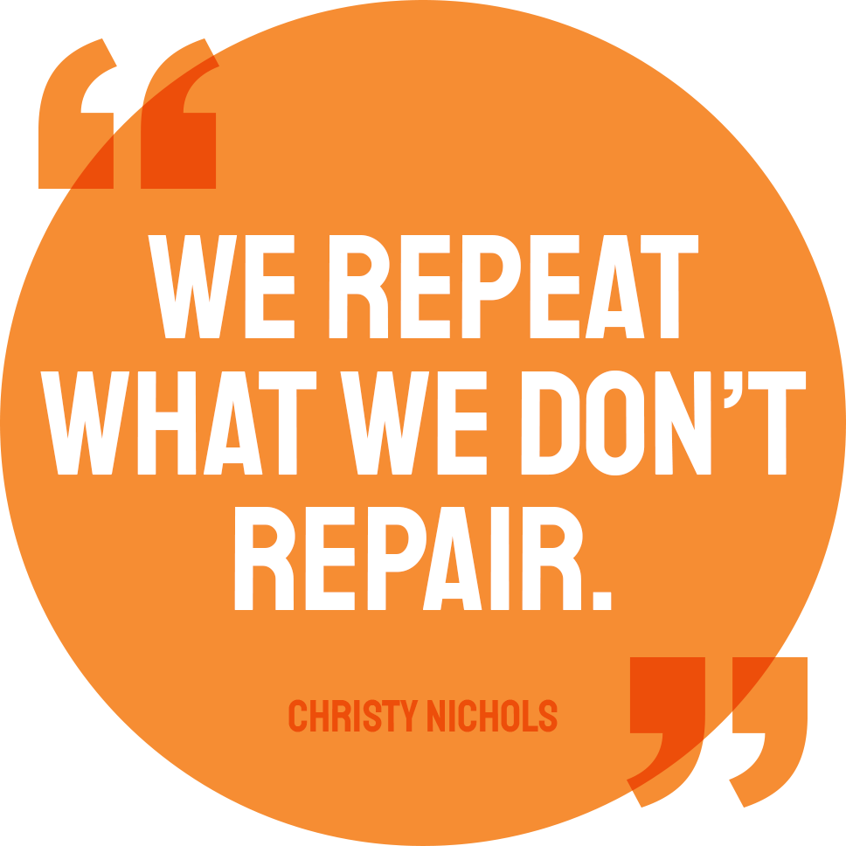

Slide 21
Strengthening my BUNGEE Rope, by adding to Scripting Tool-kit
There is no ‘gene’ for addiction, but as you have seen, lifestyle choices can influence gene expression and be ‘passed on’– from others to you, and you to others. However, new choices, behaviours and environments can have a positive epigenetic impact too.
You always have choice, and even as poor choices will undermine your physical, mental. social and emotional resilience so good choices can do the opposite. Though some decisions can be really tough, with help from wiser, more experienced and caring others, your good choices can craft you for the better and undo some bad developments.
Any substance use during your formative years only diminishes you, your potential and your resilience. Best practice is not to say ‘yes’ to use.

Slide 22
Strengthening my BUNGEE Rope – Filling Your Wheelbarrow with good stuff!
Click on links below
Impacts of cannabinoid epigenetics on human development – 2020
Drug Policy Building or demolishing community resiliency
Social Determineants & Substance Use
Cannabis Conundrum Information Sheet
Vaping crisis Information Sheet
MORE RESOURCES FOR BUILDING RESILIENCY WITHOUT DRUG USE
www.dalgarnoinstitute.org.au

