Slide 1
#WorldDrugDay #WorldResiliencyDay
BUILDING RESILIENCY AGAINST DRUG USE FOR TEENAGERS (AGED 9-12)
WORLD DRUG DAY
DALGARNO INSTITUTE

Slide 2
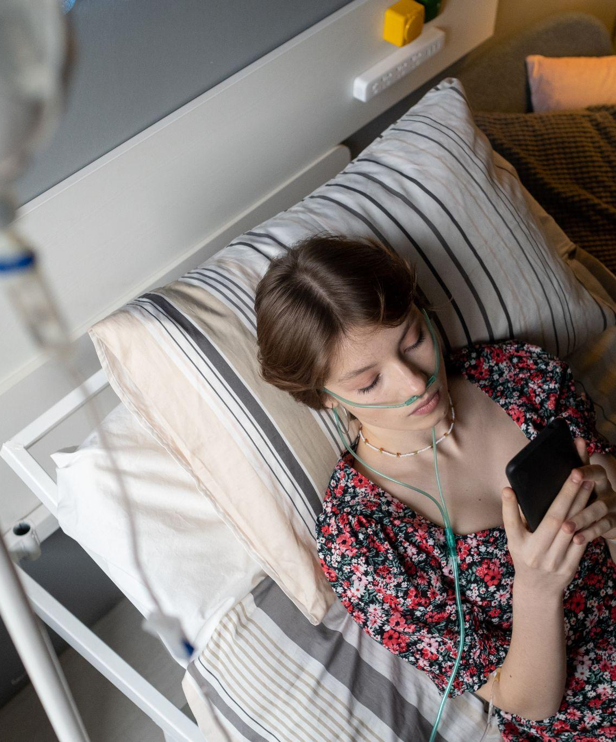
Introduction
IMPORTANCE OF ADDRESSING DRUG USE AMONG YOUNG ADOLESCENTS
Goal: Equip teenagers with knowledge and tools to resist drug use
Who will YOU be?
Outline of presentation
MAKE A CHOICE

Slide 3
Drugs and Effects
UNDERSTANDING DRUGS AND THEIR EFFECTS
Definition of drugs
Examples of common drugs and their effects
Consequences of drug use on physical, mental, and social health

Slide 4
The reasons
REASONS TEENS MAY USE DRUGS
PEER PRESSURE
COPING MECHANISM
Peer pressure is a significant factor because adolescents often seek acceptance and validation from their social circles, making them susceptible to engaging in risky behaviors, including drug experimentation, to fit in with their peers.
Teens may use drugs as a way to cope with stress or emotional pain because they may perceive substances as a temporary escape or relief from their problems, even though this often exacerbates their issues in the long run.
CURIOSITY
MISINFORMATION FROM MEDIA
Curiosity is a contributing factor because adolescents, who are naturally curious and inclined to explore new experiences, may experiment with drugs to satisfy their curiosity and discover the effects of these substances firsthand.
Misinformation from media can contribute to teen drug use because inaccurate or glamorized portrayals of drug use can lead adolescents to believe that these substances are less harmful or more socially acceptable than they actually are.

Slide 5
Building resiliency
BUILDING RESILIENCE - OPEN COMMUNICATION
Encourage open dialogue about drug use
Provide accurate information about drugs and their effects on physical and mental health
Address questions and concerns without judgment
Create a supportive environment for discussing difficult topics
Open Communication
Open dialogue
Accurate info
No stigma
Support

Slide 6
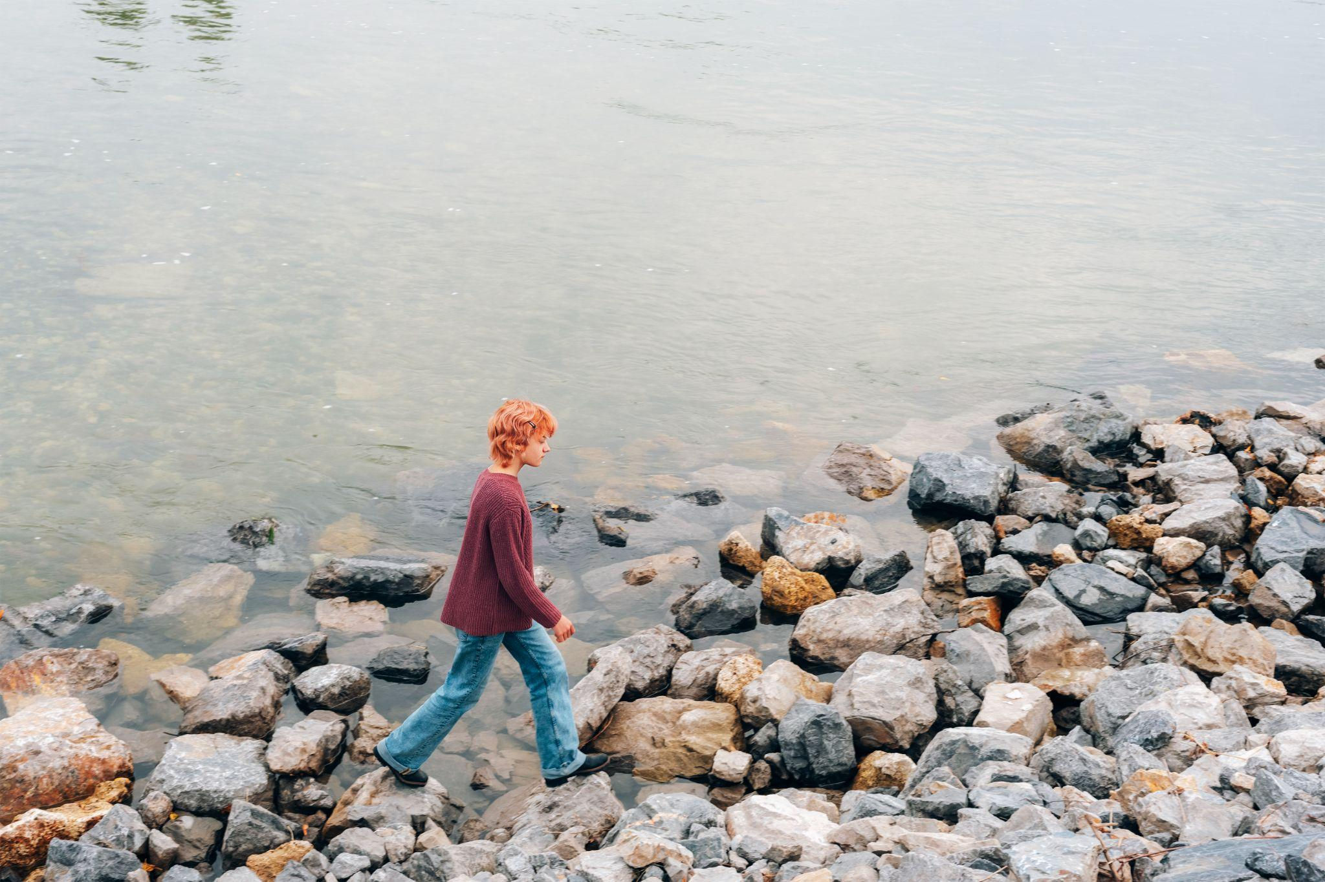
Building resiliency
BUILDING RESILIENCE -
DEVELOPING HEALTHY COPING MECHANISMS
Teach stress management techniques (e.g., deep breathing, mindfulness)
Encourage healthy hobbies and interests
Promote regular exercise and proper nutrition
Foster strong connections with family and friends

Slide 7
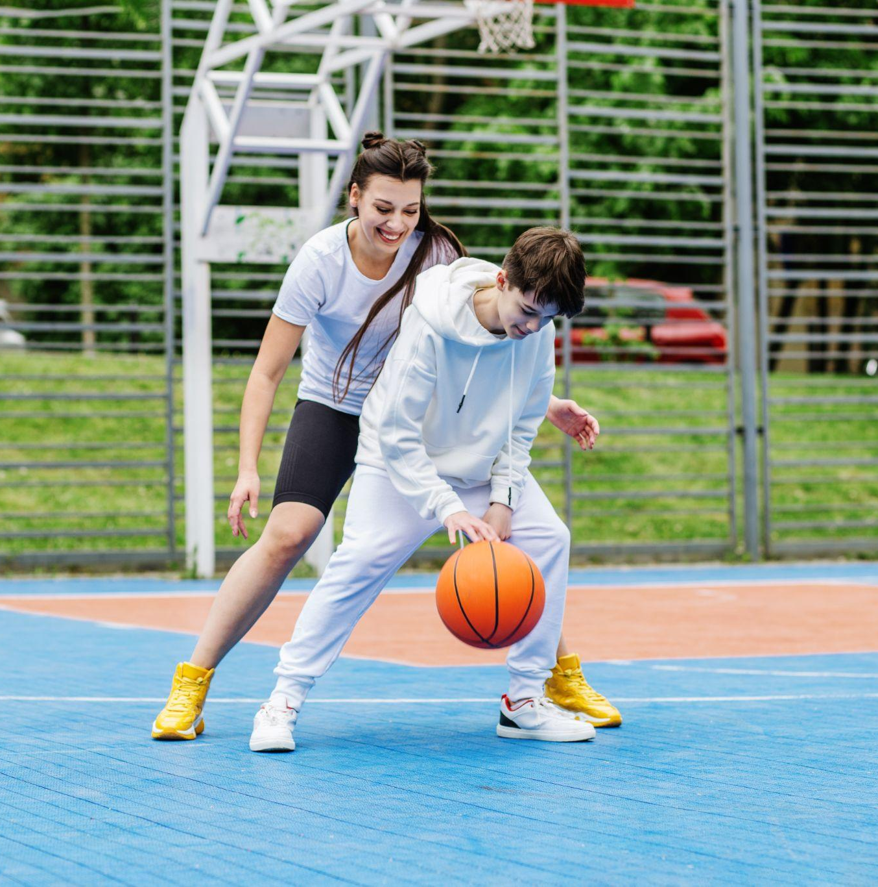
Building resiliency
BUILDING RESILIENCE -
SETTING GOALS & BUILDING SELF-ESTEEM
Set realistic and achievable goals
Foster self-worth and confidence
Celebrate accomplishments and progress
Encourage responsibility and accountability

Slide 8
Building resiliency
Teach decision-making strategies (e.g., weighing pros and cons)
Discuss real-life scenarios involving peer pressure and drug use
BUILDING RESILIENCE -
DECISION-MAKING
SKILLS
Encourage
Reinforce
Assertiveness & Values
Making healthy choices

Slide 9
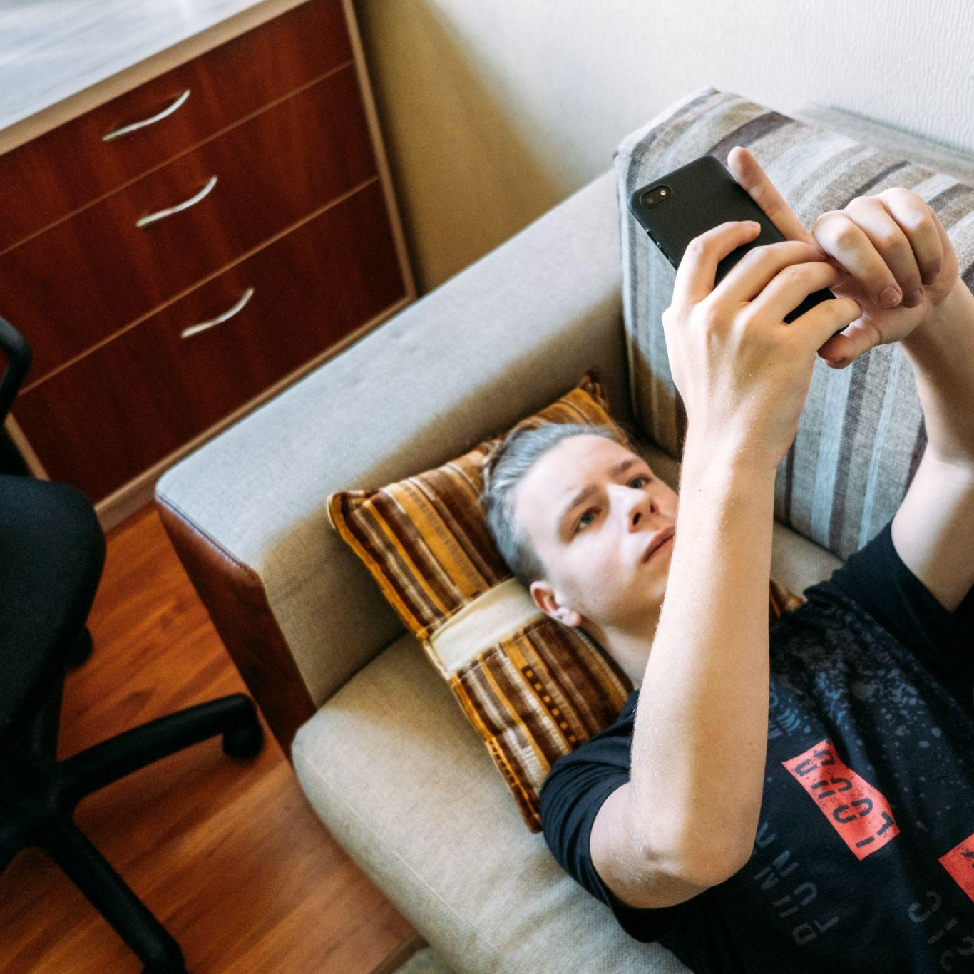
Building Resiliency
BUILDING RESILIENCE -
IDENTIFYING & AVOIDING RISKY SITUATIONS
Recognize situations where drug use may be present
Develop strategies for avoiding or leaving risky environments
Encourage teens to choose friends who share similar values and interests

Slide 10
Building resiliency
BUILDING RESILIENCE -
ACCESSING SUPPORT
Identify trusted adults or resources for support and guidance
Encourage seeking help when facing challenges or difficult decisions
Promote the importance of community and school education

Slide 11
Building resiliency
Education matters in building resiliency against drug use for teenagers.
- Dalgarno Institute -

Slide 12
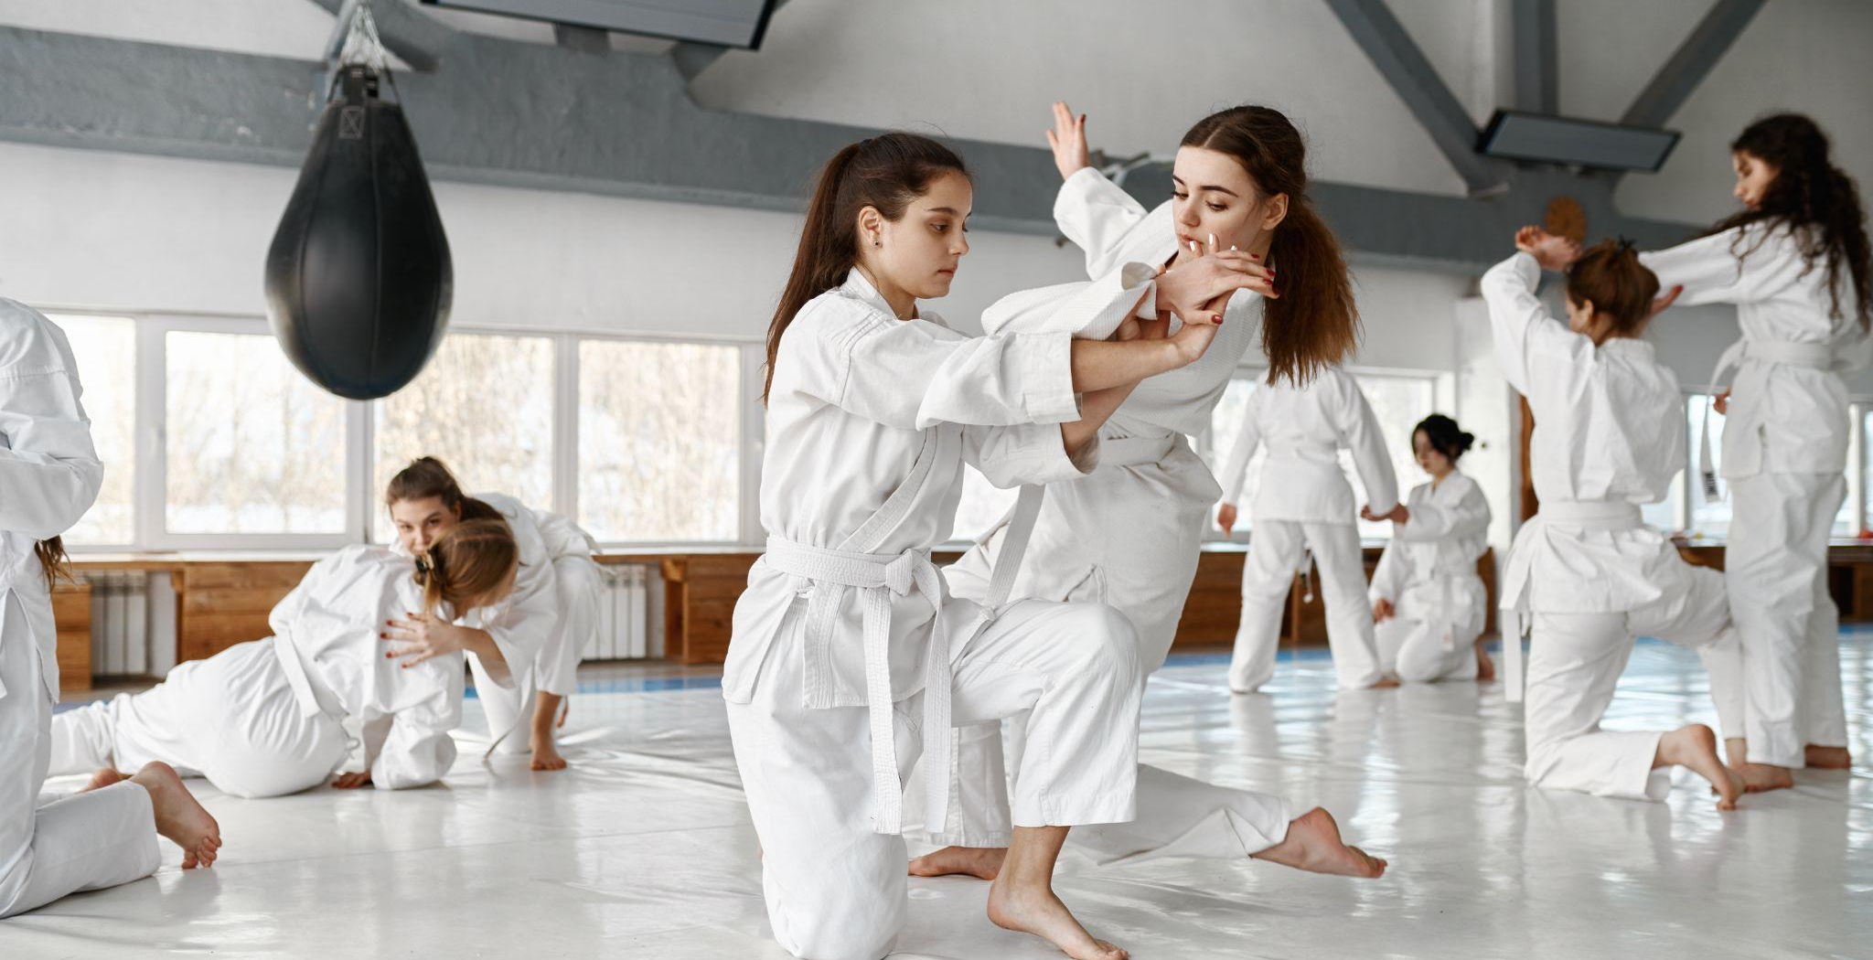
Conclusion
CONCLUSION
RECAP
ENCOURAGE
key points for building resiliency against drug use
ongoing dialogue and education about drug prevention
HOW?
EMPHASIZE
WHAT?
the importance of a supportive network and healthy coping mechanisms
WHY?

Slide 13
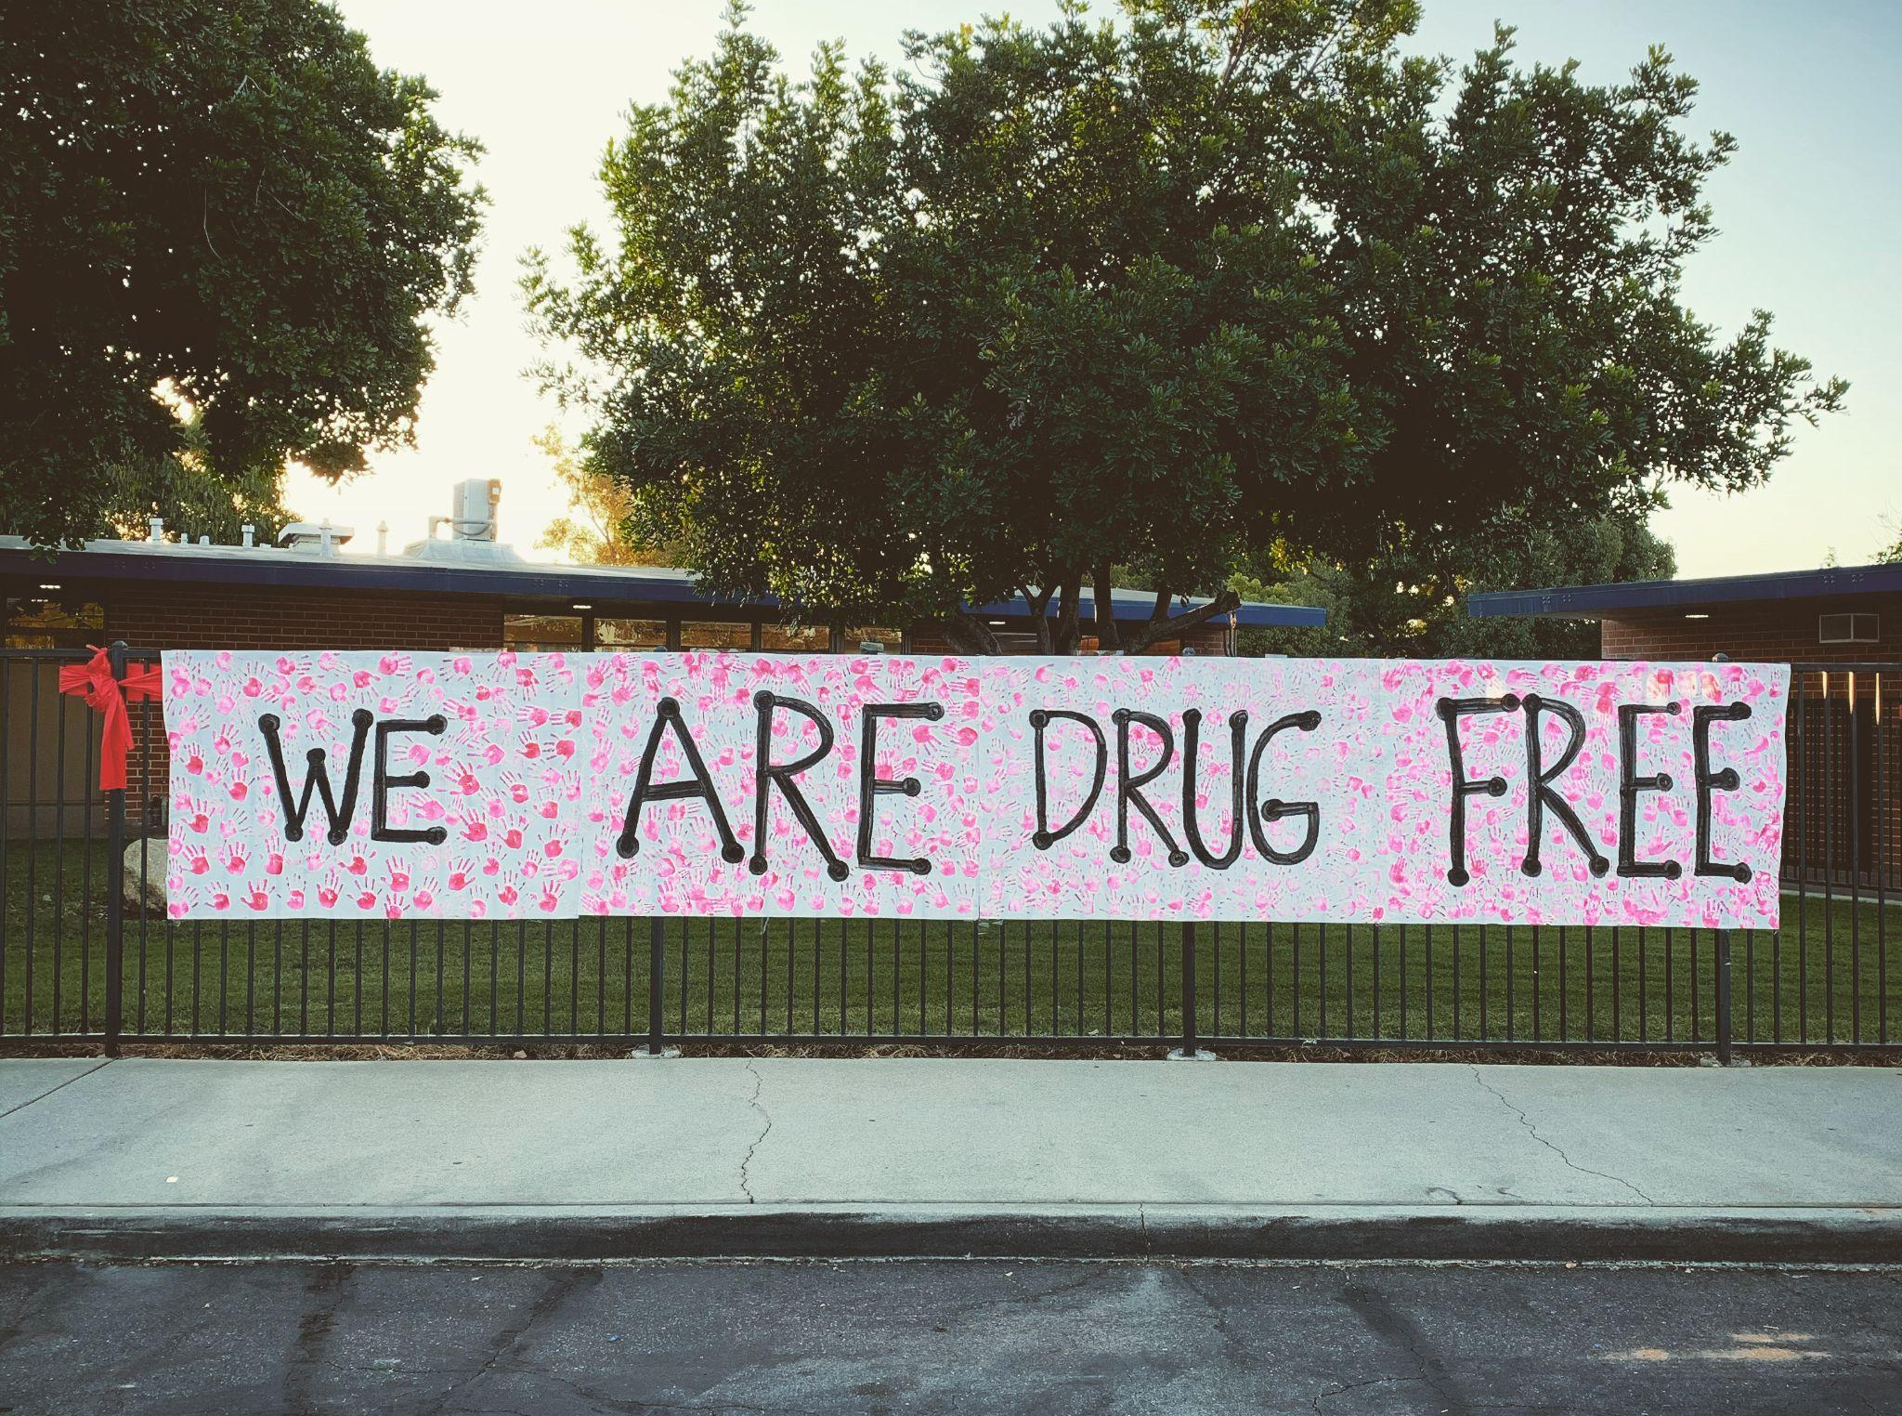
Contact
CONTACT US
Building Resiliency Against Drug Use For Teenagers
ADDRESS
PHONE
EMAIL
PO Box 7005, Dandenong, VIC 3175, Australia
1300 975 002
education@dalgarnoinstitute.org.au

Slide 14
Thank You
THANK YOU

